Slide 1



CGpa calculator
Web to calculate your Cgpa

Slide 2
Library Used in the code
Streamlit
Import streamlit as st
It helps to create
Title(st.title)
Input(st.number_input)
Buttons(st.button)
Subheadings(st.subheader)
Success(st.success)
Error(st.error)

Slide 3

OVERVIEW:
Enter No. Of subjects
Enter subject marks and credits
Get CGPA

Slide 4
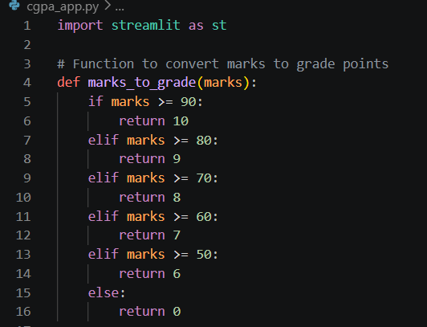
Marks_to_grade is the function that converts marks to grade

Slide 5
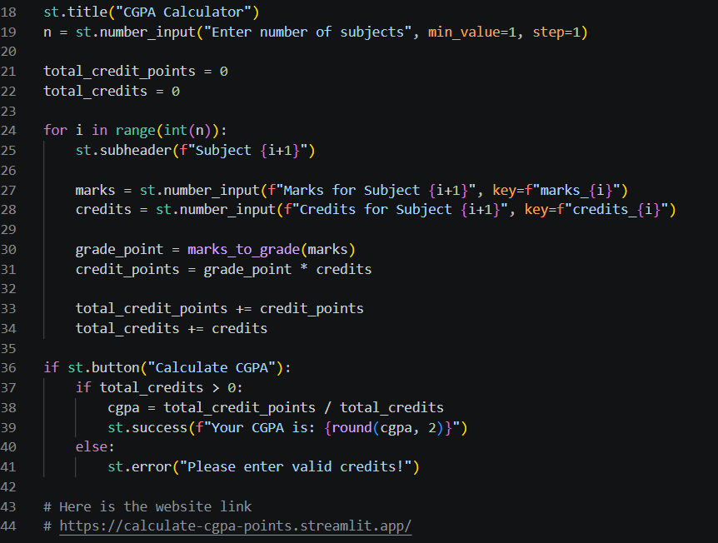
Title, Subheader, button

Slide 6
Logic used in the program
Enter marks and credits for each subject
Convert marks into grade points
Multiply grade points with credits
Add all credit points and credits
Calculate CGPA
CGPA = Total Credit Points ÷ Total Credits
Display the CGPA result

Slide 7
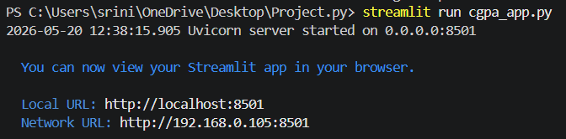
output
Type these in terminal to get link
pip install streamlit
streamlit run cgpa_app.py

Slide 8
Learning Outcomes from Project
Learned how to build simple websites using Streamlit.
Learned how to design user-friendly interfaces for web applications.
LINK: https://calculate-cgpa-points.streamlit.app/
Done By
R. Harsha Nandini
Section-4
CDS/2025/1232
(NO CONTRIBUTORS)

